Slide 1
Publication and impact in English

Slide 2
Uses
Citation counting can be used to compare:
Journals
Articles
Researchers
aims to use quantitative methods to provide a measure of research impact
based on counting number of times journal articles have been cited in other scholarly works

Slide 3
Uses
Who is citing my articles?
How many times have I been cited?
What are the best journals in the field of Education?
Which journal should I publish in?
How do I know this article is important?
Notes:
Bibliometrics can help decide both where to publish (thinking in terms of delivering future research impact) and what impact your publications are having.

Slide 4
Uses
Comparing universities
UK 8.6% versus US 34% of world research but similar impact figure of about 1.06
Figures from Incites using Web of Science citation data
Ranked lists of researchers within a university
Comparing countries
Notes:
It can also be used by senior managers and funding bodies to inform decisions such as who to employ or fund
For example, the Incites tool which is a Thomas Reuters product which looks at Web of Science citation data showed that the UK is much more effective at research than the USA, i.e. that although the UK spends less & has less researchers, their articles get cited far more

Slide 5
Uses
Research Excellence Framework (REF) is the current UK system for assessing the quality of research in UK higher education institutions
selective allocation of research funding to UK universities
benchmarking information and establish reputational yardsticks.
Some sub panels will use citation data as well as their own expert peer review to aid their decisions
Education sub panel will not use citation data in the REF 2014
Notes:
Research Excellence Framework (REF) is the current UK system for assessing the quality of research in UK higher education institutions (HEIs).
It replaces the Research Assessment Exercise (RAE)
selective allocation of their research funding to UK universities, with effect from 2015-16
benchmarking information and establish reputational yardsticks.
Some sub panels will use citation data (from Elsevier’s Scopus database) as well as their own expert peer review to aid their decisions

Slide 6
Criticisms
Bibliometric measures are not without criticism and are by no means universally accepted
May be more useful in some disciplines than others
Difficult to fairly compare across disciplines
Assumes a direct relationship between the quality of a paper and the number of citations it accrues
‘Gaming’ e.g. self citations by authors or within journals
Academic communication and publication is not just in journals
Notes:
Impact factors are often used, controversially, as a proxy for journal quality and, even more contentiously, for the quality of individual papers published in the journal and even of the people who write them.
Bibliometrics golden rule - compare like with like
REF Pilot Study "The number of times that papers are cited is not in itself an informative indicator; citation counts need to be benchmarked or normalised against similar research. In particular citations accumulate over time, so the year of publication needs to be taken into account; citation patterns differ greatly in different disciplines, so the field of research needs to be taken into account; and citations to review papers tend to be higher than for articles and this also needs to be taken into account."
(50% of the average social science journal article references are to books and other non-journal references)

Slide 7
Criticisms
The impact of research, especially in practitioner focussed disciplines is much more than counting citations
ESRC already see impact in a much broader societal context.
E.g. case studies http://www.esrc.ac.uk/news-and-events/features-casestudies/case-studies/24124/improving-the-school-league-tables.aspx
Research Councils UK (RCUK) defines research impact as 'the demonstrable contribution that excellent research makes to society and the economy'.

Slide 8
Other ways of deciding where to publish
Look at the editorial policies of the journal – rigour of the peer review process?
Look at editorial board membership
Look at seminal authors’ bibliographies of publications to see where they have published
Is a journal indexed in key subject databases / repositories?
Guidance of professional bodies and associations, and networking with peers

Slide 9
Conference papers as an alternative?
In terms of research impact, publishing in journals alone can be problematic in subjects where research develops rapidly
The process of publishing journal articles is slow and convoluted
In some subjects presenting papers at prestigious conferences may be more advantageous
Think about the acceptance rates of papers submitted (*if rates are publicised!) – the lower the acceptance rate the more prestigious the conference
Make sure that the conference has a rigorous peer review process of papers submitted
Professional contacts / bodies may offer more guidance

Slide 10
Journal Citation Reports (JCR)
Produced by Thomson Reuters in conjunction with the Institute for Scientific Information (ISI)
Commercial product available as part of the Web of Knowledge database suite
Provides citation data for journals primarily in the Sciences and Social Sciences
Includes information on journals impact factor
The original measure - JCR coined (and indeed trademarked) the phrase ‘impact factor’
Expanded to include variations on the original calculations, e.g. 5 year, eigenfactor, so variety of rankings can be explored and compared

Slide 11
Journal Impact Factors
In a given year the impact factor of a journal =
average number of citations received per paper published in that journal during 2 preceding years
Therefore journal with impact factor 8 in 2013:
Papers published in 2011 and 2012 received an average of 8 citations each

Slide 12
Eigenfactor
How many citations THIS year from articles published within the last 5 years
Also considers which journals these articles have come from and weights those from highly cited journals
Avoids self-citation within journals – i.e. ignores citations from the same journal

Slide 13
Criticisms of Journal Citation Reports
Journal rankings vary widely between disciplines:
only relevant to compare journals within same discipline
“walled garden of data”: only looks at journals listed within Thomson’s Web of Science. JCR includes:
8,500 journals (Science edition)
3,000 journals (Social Sciences edition)
i.e. a small minority of the journals in publication, so most journals do not therefore have an ‘Impact Factor’
Few Open Access journals are included
application process of a journal being included in JCR is long and convoluted
English language bias
Notes:
Numbers up to date Jan 20014
weakness in IF:
e.g. US bias / optimized for hard sciences / can be manipulated / over dependence on a single measure/ ‘2 year window’ formula too short

Slide 14
SCImago Journal Rank (SJR)
Free resource aiming to provide similar information to journal impact factors in JCR
Ranks journal publications based on citation data for approximately 20,000 journals indexed Elsevier SCOPUS database
This is the citation data that will be used by the REF where citation data of individual papers is considered
http://www.journalmetrics.com/

Slide 15
Advantages of SJR rankings
Elsevier product using commercial Scopus database, but the citation metrics are available free, so are subscription is not essential
Subject coverage: includes broader range of subjects incl. those not covered in JCR e.g. Religious Studies
Number of journals covered far greater, includes more Open Access journals
claims to take account of journal prestige (similar to Eigenfactor)
updated more often than JCR

Slide 16
Measuring the impact of your research
There are also bibliometric measures designed to illustrate the impact of individual researchers’ work
Statistical measures are based on a calculation called the H-index
An author’s number of articles (h) that have received at least h citations

Slide 17
What does this mean?
a researcher with an h-index of 10:
published 10 articles that have each been cited at least 10 times
If you search for an individual author’s papers in Web of Science you can calculate their h-index

Slide 18
Criticisms of the H index
High h-index scores may indicate a researcher having a significant impact
Low h-index scores doesn’t mean the opposite
Weak citation data often caused by:
Working in a small field (therefore generating fewer citations in total)
Publishing in a language other than English (effectively also restricting the citation field)
Publishing mainly (in) books / monographs

Slide 19
Publish or perish
Free download software designed to measure researcher and journal impact
Citation data sourced from Google Scholar
Advantages:
Data for broader range of documents e.g. books
Broader range of documents contribute to higher number of citations
More useful for recent documents
Useful for subjects not covered by JCR
More comprehensive in some areas
Open access journals included
Publish or Perish
Notes:
http://www.harzing.com/pop.htm
Publish or Perish is spftware that was created by Jane Harzing. It provides the' sanitized' version of Scholar's results, i.e. without the 'noise' from blogs and incidentary references to the article. And you can see not just the number of times an article is cited but how many times per year it has been cited.
Although Google Scholar performs better than the Web of Science in this respect, it is still not very good in capturing LOTE articles and citations, or citations in books or book chapters. As a result, citation metrics in the Social Sciences and even more so in the Humanities will always be underestimated as in these disciplines publications in LOTE and books/book chapters are more likely than in the Sciences.

Slide 20
Google Scholar citation data
Advantages:
Data for broader range of documents e.g. books
Broader range of documents contribute to higher number of citations
More useful for recent documents
Useful for subjects not covered by JCR
More comprehensive in some areas
Open access journals included
Disadvantages:
Some concerns about data quality
Unknown source base
Still not great on languages other than English
Google Scholar also allows you to set up an author profile which contains your citation metrics
Notes:
Inevitably, the number of citations on Google Scholar will be higher because Scholar captures ALL citations of the article no matter where it appears. The citations on Google will include a reference on a blog post, a lesson plan, a reading list or in journals that are not indexed by the WoS. These are referred to as 'grey' literature and may not be appropriate for pure bibliometrics.
Computing for instance is all about conferences so Scholar a good way to get this data, which would be less likely to be available in Scopus or JCR

Slide 21
Measuring impact of articles
Often useful to track citations on particular papers, for instance:
Track future citations of articles you have written
Tracing research forward in time will allow you to see how an idea has been confirmed, applied, improved or corrected
by setting up a citation alert you can continue to be notified when the paper you are interested in has been cited again after your initial literature search
Web of Knowledge offers both citation data for individual papers and the ability to set up citation alerts
BUT citation data only available for journals indexed in Web of Knowledge (i.e. a subscription database with limited scope)
Google Scholar shows citation counts under each result

Slide 22
Are future citation counts and overall reach of research the same thing?
Citation data is only one measure of the impact of a piece of research
The overall ‘reach’ of a piece of original research may not necessarily be furthered just by publishing in a traditional peer-reviewed journal with a high impact factor
Not many people may get to read it!
Open Access publishing may greatly increase the readership of a piece of research
As a consequence this could also then actually increase future citation as well

Slide 23
Other means of illustrating your research impact
Citation data (particular from journals) may not be the most appropriate means of illustrating research impact particularly for early career researchers:
Published conference papers (from high prestige conferences)
Download statistics from personal web page / repository (in the case of Open Access work)
Awards of grants, scholarships, prizes
Awards of research funding
Organisation of conferences
Participation as journal article / conference paper reviewer

Slide 24
Future
Yet more variations on impact factor calculations are being developed all time
Journal Usage Factor (UF) is one such metric in development. Key features of the metric will be:
Calculated using the median of usage over 2 years (not arithmetic mean)
To be comparable within subject areas, but not across disciplines
UF for all subjects (practitioner oriented-subjects where content may be heavily used but not cited

Slide 25
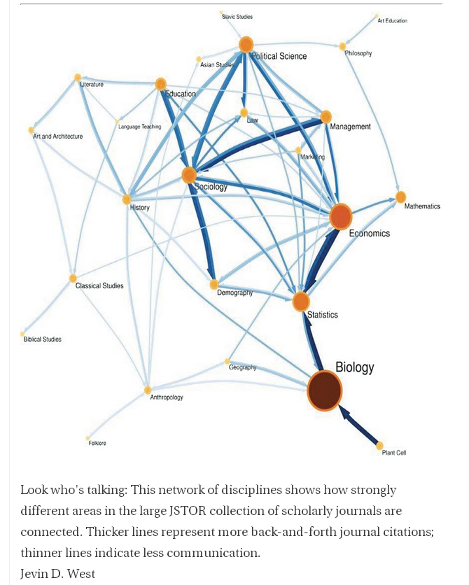
Future
Differing models of display
citation networks that could help researchers find relevant articles
http://chronicle.com/article/Maps-of-Citations-Uncover-New/128938/

Slide 26
Future
In today's digital world, researchers share materials online, and the wider public can engage with research outputs via a variety of different media such as twitter, blogs, news reports etc. Often this means impact can be seen more quickly, with research having a broader outreach
A movement called ‘altmetrics’ attempts to explore alternatives to traditional bibliographic citation counting

Slide 27
Altmetrics
attempts to capture the internet buzz that greets new publications
http://www.altmetric.com/
Notes:
http://libguides.city.ac.uk/altmetrics

Slide 28
Future
Collecting your own data
e.g. Academic networking sites such as Academia.edu provide usage data which can be used to show that your papers actually get looked for online
https://oxford.academia.edu/KenMayhew
Followers, documents views, profile views, analytics (on your own profile, e.g. Search & redirections from Google)

Slide 29
Conclusions
Bibliometrics are one method of both choosing where to publish and measuring the impact of research
Can help decision-making processes on publication and also help provide evidence of research impact
But all statistical measures have flaws and criticisms
Remember that citation data may be more or less relevant depending on your discipline
There are other ways of making decisions on where to publish and illustrating your scholarly worth

Slide 30
Further reading
http://www.esrc.ac.uk/funding-and-guidance/impact-toolkit/index.aspx
http://www.vitae.ac.uk/researchers/1272-264191/The-engaging-researcher.html
http://www.rin.ac.uk/our-work/communicating-and-disseminating-research/social-media-guide-researchers
http://www.altmetric.com/
http://www.timeshighereducation.co.uk/news/use-impact-agenda-to-prove-value-social-sciences-urged/2010277.article
http://www.ref.ac.uk/subguide/citationdata/

